Slide 1
Computer Vision and Image Processing
Trigul 1
Introduction to OpenCV in Python
By Shai Aharon & Moriya Bitton

Slide 2

What is OpenCV?
OpenCV (Open source Computer Vision) is a library containing functions mainly aimed at real-time Computer Vision and Image Processing.
Originated from Intel Research in 1999
Version 1.0 came out in 2006.
Supports multiple languages such as C/C++, Python, Java and more.

Slide 3
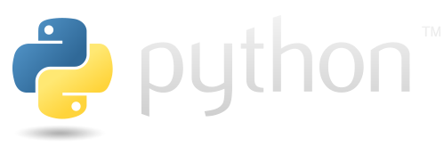
Python
Created by Guido van Rossum (retired last year) and first released in 1991
Its goal is to help programmers write clear, logical code for small and large-scale projects
It is a script language, that means, no compilation. Reads the code as it runs.
Dynamic typed (No ‘int x..’)
Garbage collector (Like Java)
Latest stable version is 3.8, no need to worry about versions, as long as you use 3.x,
2.x is officially dead as of January 1st 2020, and is not compatible with 3.x

Slide 4
Why Python?
It’s and fast to write.
It’s free! (unlike MatLab)
Very popular in the academia, most of academic papers will have a python implementation.
Extremely popular in the industry, Google supports it (YouTube is in python).
Has a lot of official libraries, and even more unofficial.
Fun fact: It was named after “Monty Python” the famous the British comedy group.
Fun fact II: Google “python easter eggs”

Slide 5
OpenCV in Python
For this class we are going to use
Python 3.7+
Opencv 4.x
Numpy 1.16.4+ - The Python matrix library, very useful
Usually there isn’t a big difference between version
except new ‘tricks’, but it’s best to be on the safe side.

Slide 6
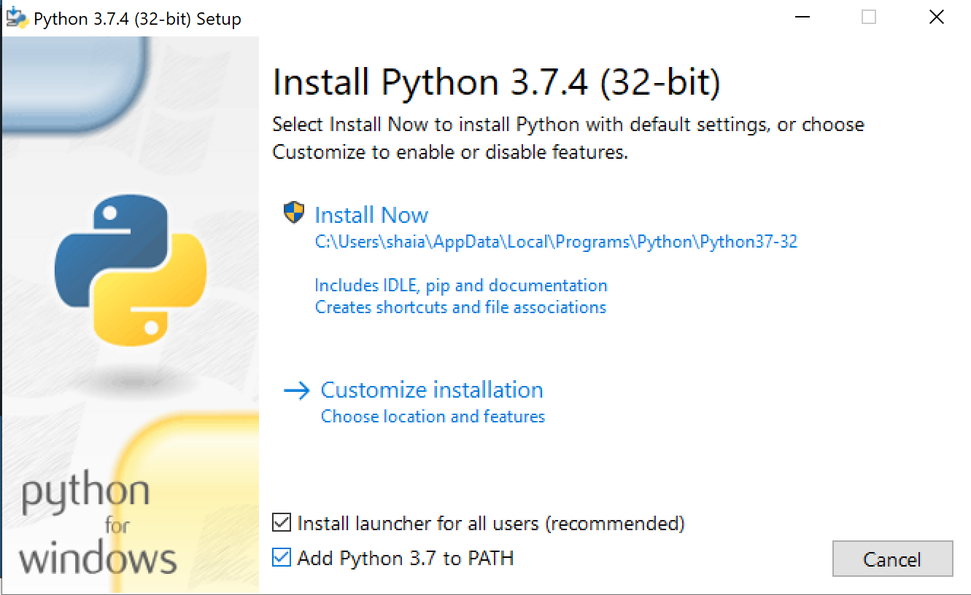
Let’s Start!
Installing opencv for python
https://www.python.org/

Slide 7
Before we start..
Type in the command line:
> pip install numpy > pip install opencv-python

Slide 8
Numpy
Numpy array (np.ndarray) is a matrix object
OpenCV uses numpy arrays to store images.
>>> type(img)
<type 'numpy.ndarray'>
You can access numpy arrays the same way as MatLab matrices, but instead of (), numpy uses []. The () are saved for functions in python.
>>> a = np.array([1,2,3,4]); print(a[2])
3
>>> a = np.array([1,2,3,4]); print(a[:2])
array([1, 2])

Slide 9
Numpy Cont.
Index starts from 0 (as it should!)
>>> a[0]
1
Accessing the last cells from the end is done by negative numbers (-1==end)
>>> a[-1]
4
a = np.array([1,2,3,4])
>>> a[-2]
3

Slide 10
Numpy Cont.
Row vector: np.array([[1,2,3,4]])
Column vector: np.array([[1],[2],[3],[4]])
Matrix example:
>>> A = np.array([[1,2,3,4],[5,6,7,8],[11,22,33,44]])
array([ [ 1, 2, 3, 4],
[ 5, 6, 7, 8],
[11, 22, 33, 44] ])
A.shape = (3,4)

Slide 11
Numpy Cont.
Random access (Element accessing):
A = np.array([[1,2,3,4],[5,6,7,8],[11,22,33,44]])
A[1,2] = 7
A[0,1:3] = np.array([2,3])
A[:,3] = np.array([4,8,44])
Index accessing:
idxs = np.array([1,-1])
A[idx,:] = np.array([[5,6,7,8],[11,22,33,44])
idxs = np.array([[True,False,False,True],[False,False,False,False],[False,True,True,False]])
A[idxs] = array([ 1, 4, 22, 33])
A = [ [ 1, 2, 3, 4],
[ 5, 6, 7, 8], [11, 22, 33, 44] ]
idxs = [ [ True, False, False, True],
[False, False, False, False],
[False, True, True, False] ]

Slide 12
Numpy Cont.
A = np.array([[1,2,3,4],[5,6,7,8],[11,22,33,44]])
A<6 = array([ [ True, True, True, True],
[ True, False, False, False],
[False, False, False, False] ])
np.where(A<6) = ( array([0, 0, 0, 0, 1], dtype=int64), # array of y-coordinate indices
array([0, 1, 2, 3, 0], dtype=int64) ) # array of x-coordinate indices
A[A<6]=99 → A = np.array([[99,99,99,99],[99,6,7,8],[11,22,33,44]])

Slide 13
Numpy Cont. - Matrix reshaping
A = np.array([[1,2,3,4],[5,6,7,8],[11,22,33,44]])
A.reshape((2,6)) = array( [[ 1, 2, 3, 4, 5, 6],
[ 7, 8, 11, 22, 33, 44]] )
A[:] = A # Unlike matlab, it only returns a pointer of the matrix and does not flatten the array. To copy use np.array(A)
A.flatten() = array([ 1, 2, 3, 4, 5, 6, 7, 8, 11, 22, 33, 44])

Slide 14
Matrix Operators
A = np.array([[1,2,3,4],[5,6,7,8],[11,22,33,44]])
A.sum() or np.sum(A) → 146
For summing a specific axis: A.sum(axis=0) # axis y → array([17, 30, 43, 56])
Same goes for np.mean, np.min/max…
A+A = array( [[ 2, 4, 6, 8], [10, 12, 14, 16], [22, 44, 66, 88]] ) # Either you the matrices have the same dimension, or one of them is a scalar.

Slide 15
Matrix Operators
A = np.array([[1,2,3,4],[5,6,7,8],[11,22,33,44]])
# Just multiplies each row by the vector
A* np.array([1,1,1,1]) = array( [[1, 2, 3, 4], [ 5, 6, 7, 8], [11, 22, 33, 44]] )
# Gives you the dot product
A.dot(np.array([1,1,1,1])) = array([10, 26, 110])

Slide 16
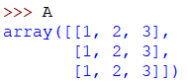
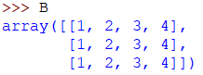
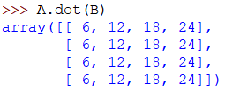
Matrix multiplication
To perform dot product of matrix A [size(3,3)] with matrix B [size(4,3)]
Don’t:
Use:
Or (new): A @ B
Faster and prone to less errors
Thumb rule: If it’s messy, Stop! You’re probably doing something wrong!

Slide 17
Vectors in numpy
>>> q = np.array([12,4,2])
q.shape => (3,)
# That means the it’s not a row nor a column.
q == q.transpose()
q.dot(q) = q.transpose().dot(q) = q.dot(q.transpose()) = 164

Slide 18
Vectors in numpy
In order to define if it’s a row or column use:
q = np.array([[12,4,2]])
q.shape = (1,3)
q = np.array([[12],[4],[2]]])
q.shape = (3,1)
q.dot(q) => ValueError: shapes (1,3) and (1,3) not aligned
q.transpose().dot(q) = array([ [144, 48, 24],
[48, 16, 8],
[24, 8, 4] ])

Slide 19
Numpy
Very flexible, easy and powerful
Has all the functions you need for matrix operations
Syntax similar to matlab (don’t forget to use []!)
Very fast! Uses cpu optimizations.
For more information checkout http://www.numpy.org/

Slide 20
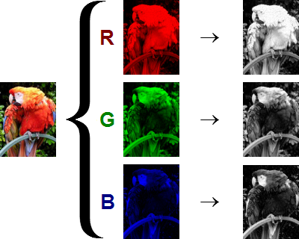
OpenCV
>>> import cv2 >>> import numpy as np >>> img = cv2.imread('parrot.jpg’) >>> img.shape
(534L, 800L, 3L) # (height, width, channels)
img is a 534 X 800 X 3 matrix,
each channel stores the one color of:
Red, Blue, Green.

Slide 21
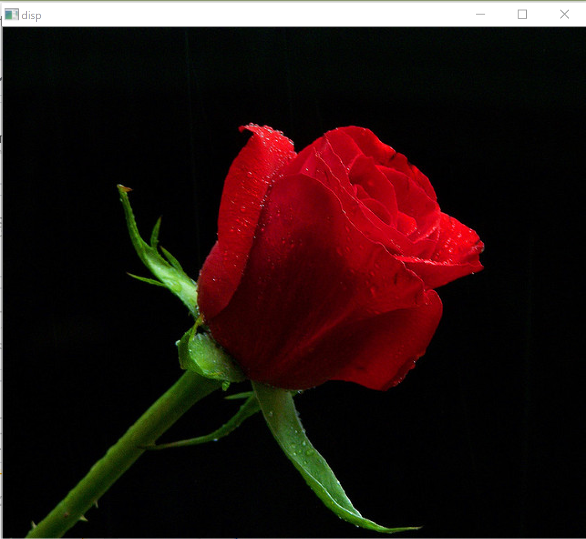
Channel ordering
>>> img = cv2.imread(‘red-rose.jpg’) >>> cv2.imshow(‘disp’,img) # (title, image) >>> cv2.waitKey(0) # show the image, and waits until # a key is pressed >>> cv2.imwrite(‘rose.png’,img) # the format (ex. png) # must be part of the name

Slide 22


Channel ordering
# If we want to see each channel by itself
# we can simply display only one channel
>>> cv2.imshow(‘disp’,img[:,:,0])
# What is wrong with the image?
OpenCV has a different channel order then most libraries for historical reasons. Instead of RGB it’s BGR.

Slide 23
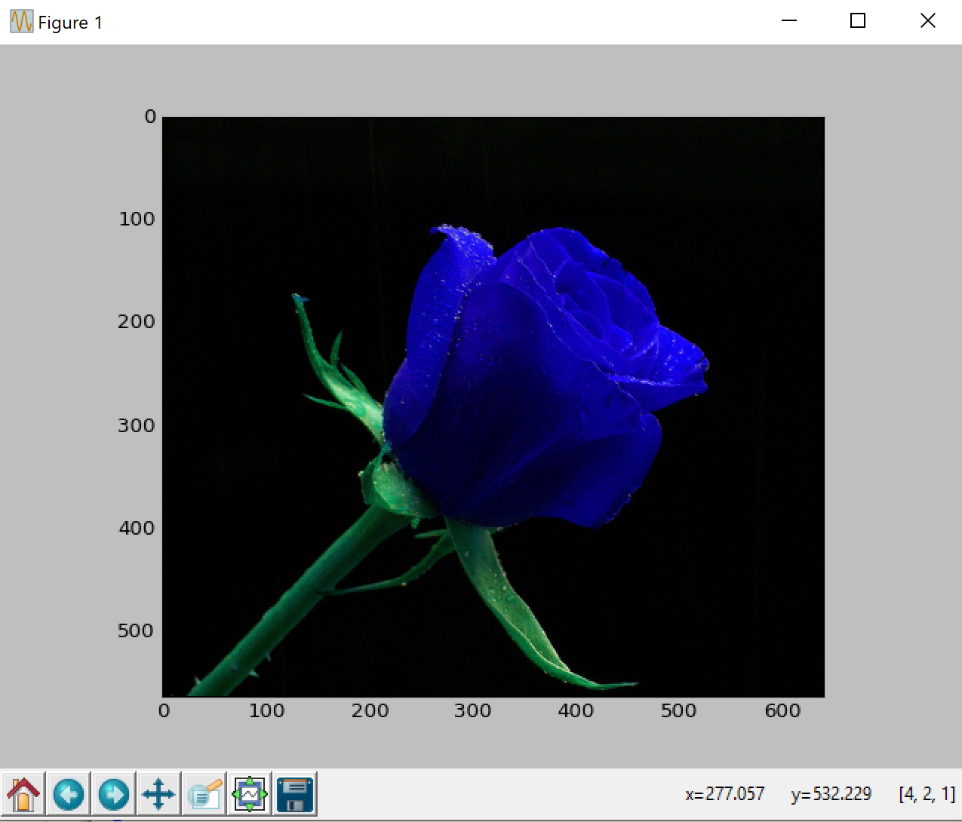
Another way to display
Meet Matplotlib! (pip install matplotlib)
Python’s matrix plotting library.
Very easy to use, and gives a lot of tools
that matlab has (You’ll need to pip install it..)
>>> import matplotlib.pyplot as plt >>> plt.imshow(img); plt.show()
You can see the values of the pixel if you hover over them, zoom, pan and much more.

Slide 24
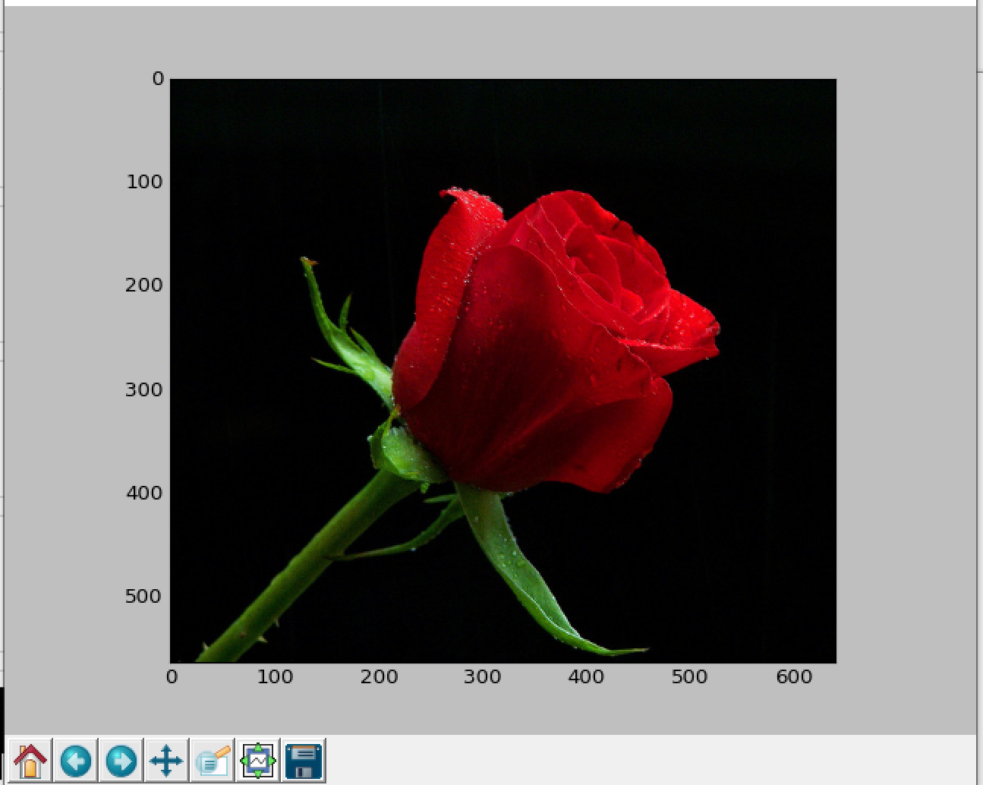
Another way to display
To get the colors right:
>>> img_rgb = cv2.cvtColor(img,cv2.COLOR_BGR2RGB)

Slide 25
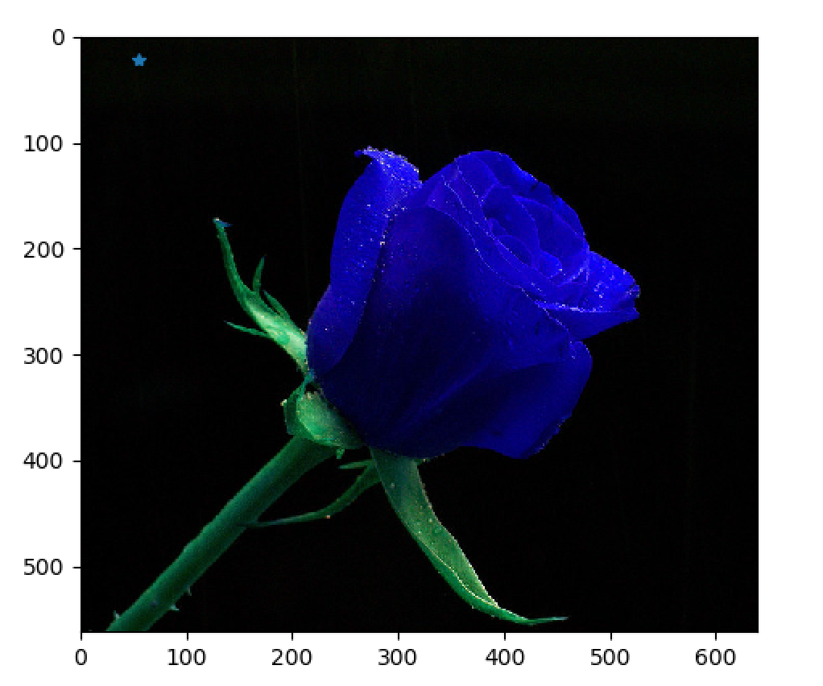
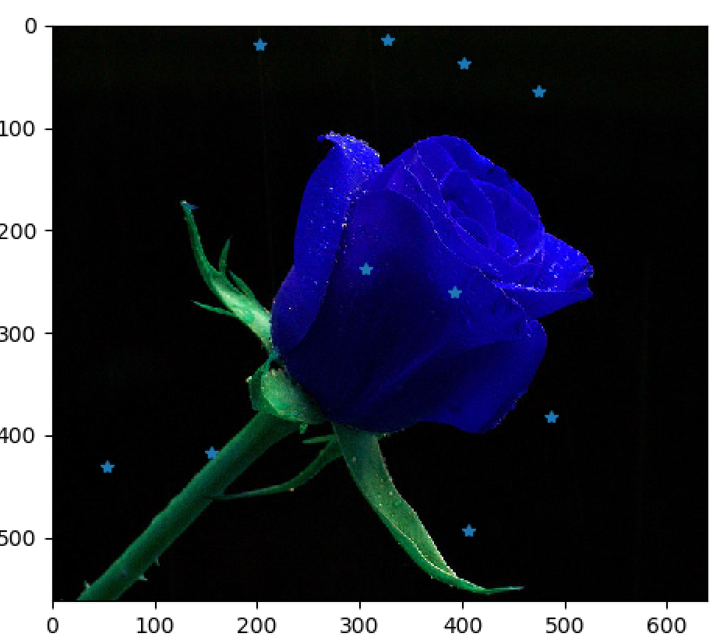
Matplotlib
Another advantage is the ‘plot’ function
>>> plt.plot(55,22,’*’) # for a point
>>> x = np.random.randint(0,500,(10,2))
>>> plt.plot(x[:,0],x[:,1],’*’) # multi-points

Slide 26
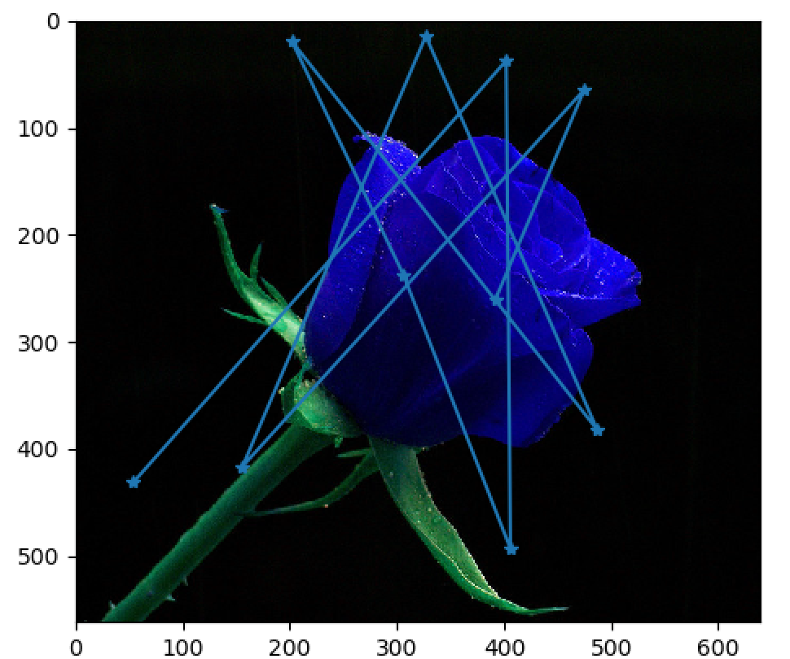
Matplotlib
>>> plt.plot(x[:,0],x[:,1],’-*’)
# use ‘-’ for lines

Slide 27
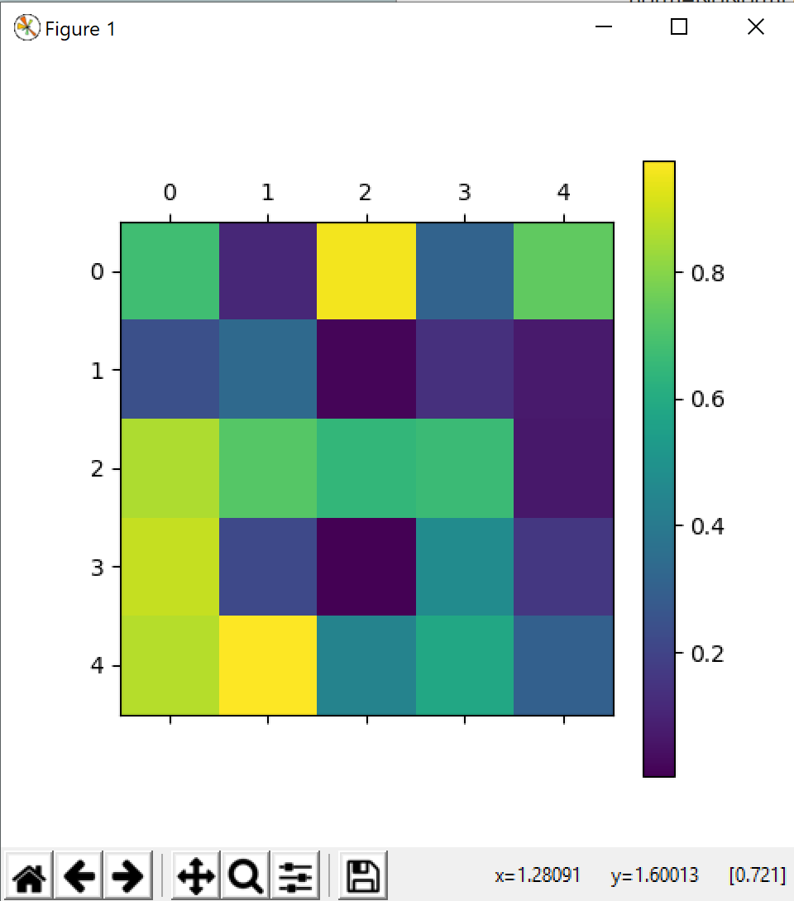
Matplotlib Cont.
If you want to visualize a matrix, you can simply type:
>>> plt.matshow(rmat) >>> plt.colorbar();plt.show()
Much better than seeing: array([ [ 0.67797161, 0.11296163, 0.95766113, 0.3129193 , 0.74013354],
[ 0.24188004, 0.3374846 , 0.01660649, 0.13949288, 0.0747959 ], [ 0.85427296, 0.72132287, 0.64931702, 0.66766803, 0.06635453], [ 0.8886909 , 0.21886522, 0.00510582, 0.47485324, 0.16304322], [ 0.86691344, 0.97534831, 0.43997722, 0.58590194, 0.30334944] ])
matshow normalizes the display values. That means that rmat and rmat*100 will look the same.
rmat**2 won’t, Why?

Slide 28
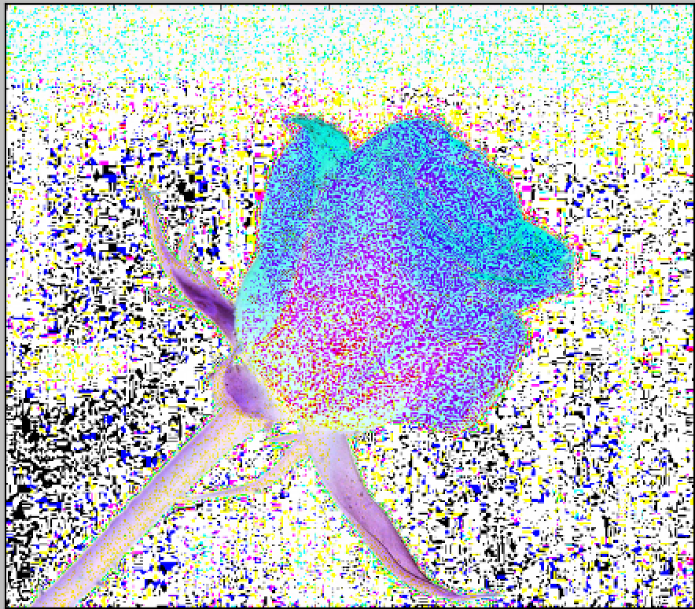
Image representing
Images can be represented as UInt8 [0,255] or doubles/floats [0,1].
A common error is having an image with values between 0 to 255, but the matrix type (dtype in numpy) is a float, thus when saving or displaying the image, it will output a white image.

